Slide 1



2024
CAPSTONE
PROJECT
by Fatma Nur Kraman

Slide 2


Overview
Introduction
About me
Database
Introduction to Chinook
Introduction of tables
Analysis of tables
Core skills
Summary and conclusion

Slide 3
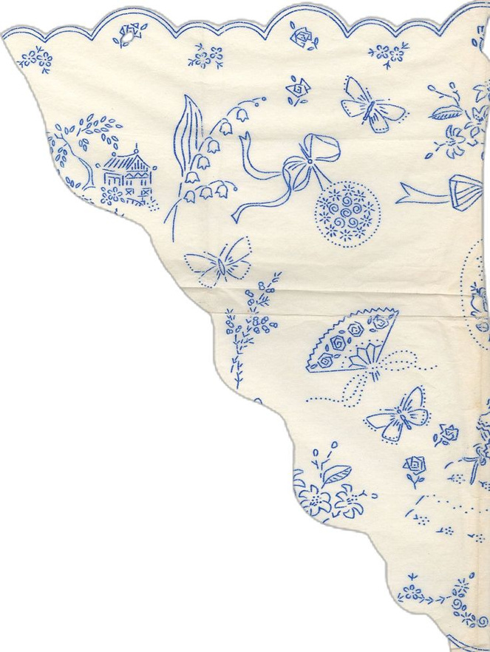





ABOUT
ME
1999
Graduation
First job
UP School

Slide 4


About
Chinook Database
The Chinook Database is a relational database designed to mimic the structure and operations of a digital media store,
focusing on data related to music, artists, albums, genres, and customer transactions.
The database includes tables for employees, customers,
sales invoices, tracks, playlists, and media formats, allowing users to simulate various real-world business scenarios.

Slide 5
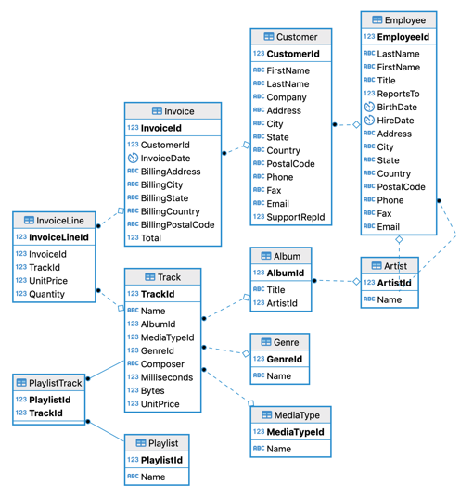

Slide 6
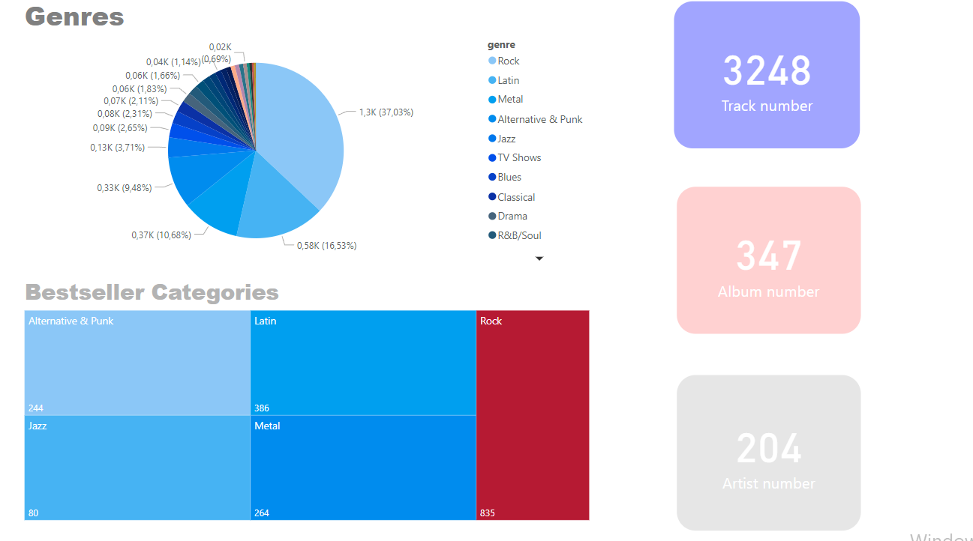

Slide 7
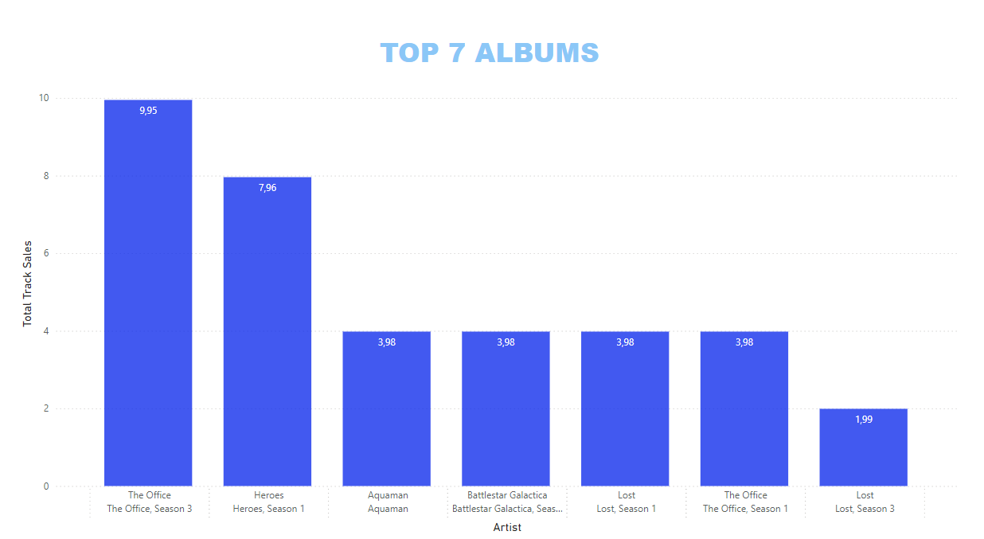




Slide 8
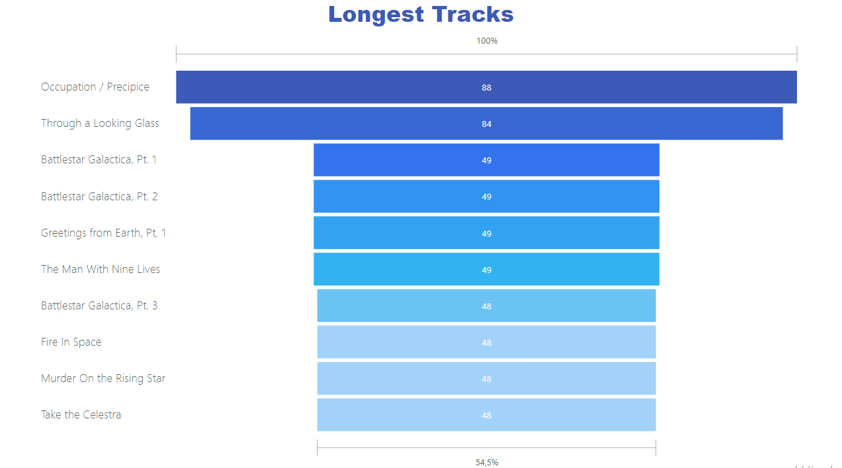

Slide 9
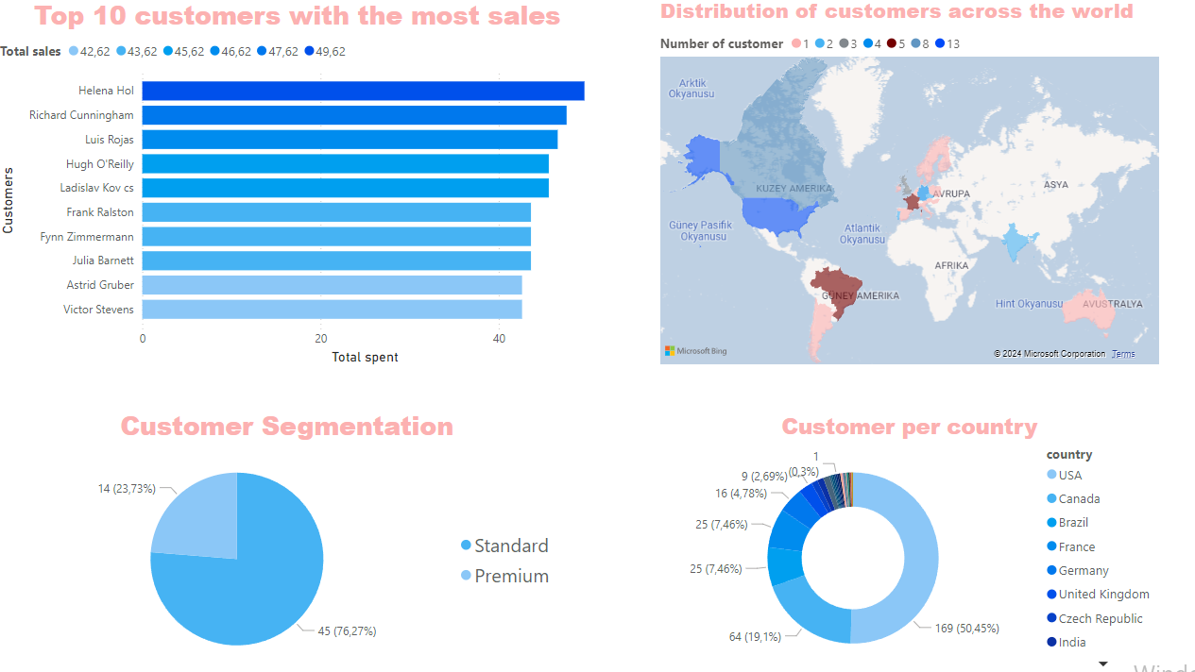

Slide 10
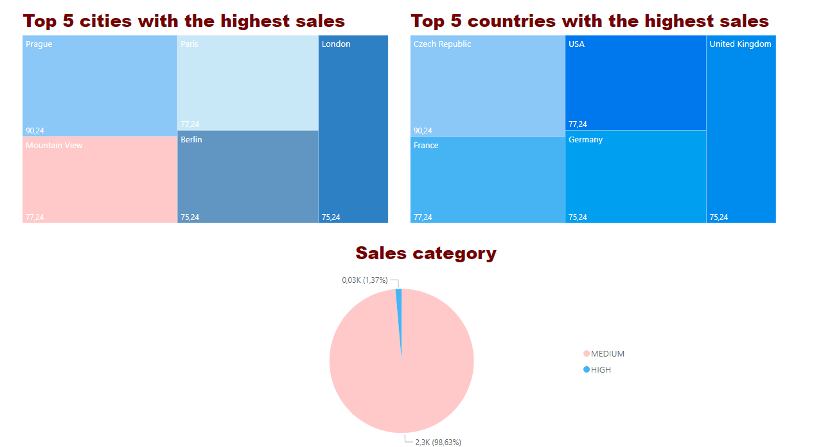

Slide 11
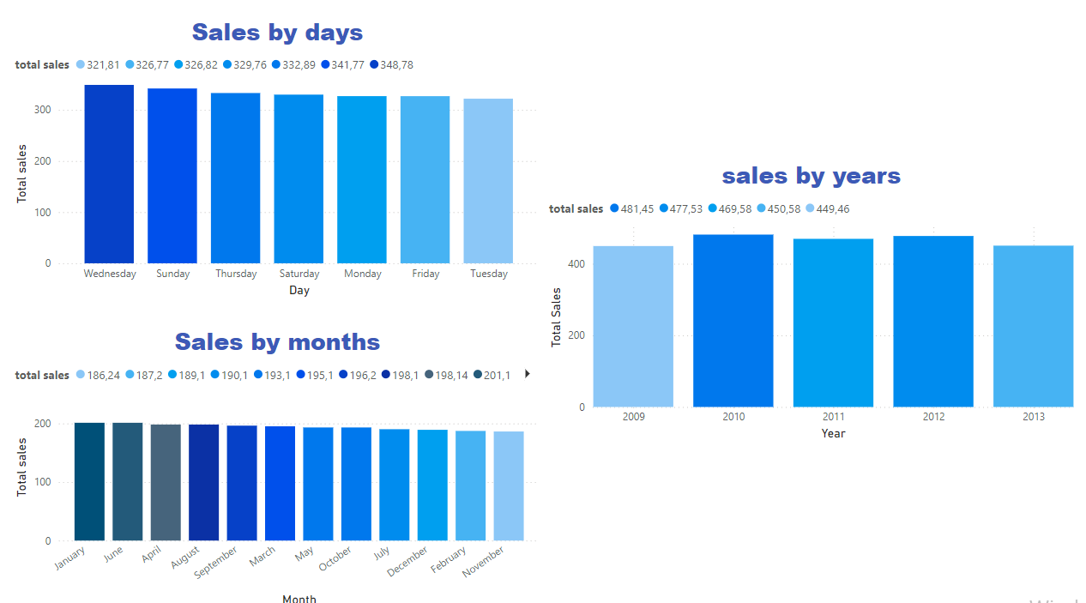


Slide 12


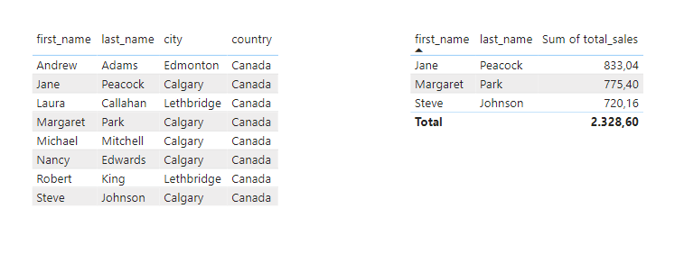
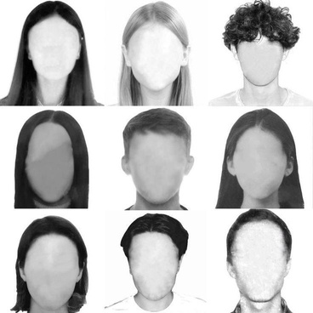
Employees

Slide 13




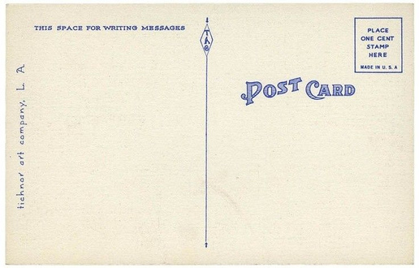
Core Skills

Slide 14

The end

